Slide 1
Globalization and the Multinational Firm
Chapter One

Slide 2
Overview
Differences between domestic and international finance
Goals for international financial management
Globalization of the world economy
Multinational corporations
1-<number>

Slide 3
International finance
  Largely stem from the fact that sovereign nations have the right to issue currencies, formulate their own economic policies, impose taxes, and regulate movements of people, goods and capital across their borders
1-<number>

Slide 4
Differences between domestic finance and international finance
  Foreign exchange risk,
  cultural differences
  political risks
  market imperfections
  expanded opportunity set
1-<number>

Slide 5
Foreign Exchange Risk
Foreign exchange risk is the risk of facing uncertain future exchange rates
  In addition to businesses, individuals and households may also be seriously exposed to uncertain exchange rates
  Exchange rates among major currencies (e.g., U.S. dollar, Japanese yen, British pound, and euro) fluctuate continuously in an unpredictable manner
  Exchange rate uncertainty influences all major economic functions, including consumption, production, and investment
1-<number>
Notes:
Fixed exchange rates were abandoned in the early 1970s.

Slide 6
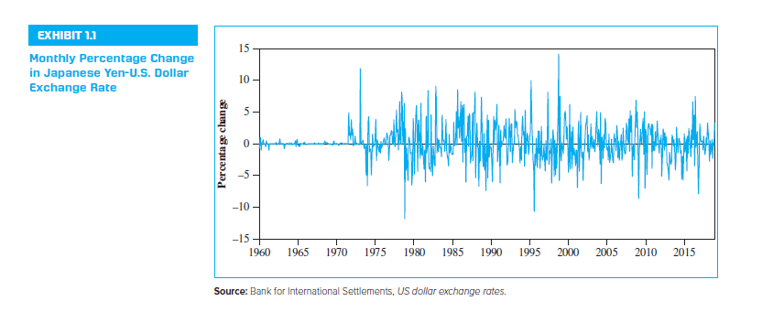
Monthly Percentage Change in Japanese Yen—U.S. Dollar Exchange Rate
1-<number>

Slide 7
Cultural differences
  Variations in language, customs, norms, etc that affect how businesses are run.
1-<number>

Slide 8
Political Risk
Political risk arises from potential losses to the parent firm resulting from adverse political developments in the host country
  Ranges from unexpected changes in tax rules to outright expropriation of assets held by foreigners, Political unrest
  Arises from the fact that a sovereign country can change the “rules of the game” and the affected parties may not have effective recourse
1-<number>

Slide 9
Market Imperfections
Market imperfections may be described as various frictions, such as transaction costs and legal restrictions, barriers to entry, monopolies, imperfect information, etc that prevent the markets from functioning perfectly
  World markets are highly imperfect (International business)
    Numerous barriers hamper the free movement of people, goods, services, and capital across national boundaries (e.g., legal restrictions, excessive transaction and transportation costs, information asymmetry, and discriminatory taxation).
  Restrict the extent to which investors can diversify their portfolios.
1-<number>

Slide 10
The Example of Nestlé’s Market Imperfection
Nestlé used to issue two different classes of common stock, bearer shares and registered shares
  Foreigners were only allowed to hold bearer shares
  Swiss residents could buy registered shares
  The bearer stock was more expensive
On November 18, 1988, Nestlé lifted restrictions imposed on foreigners, allowing them to hold registered shares as well as bearer shares
  Price spread between the two types narrowed drastically
1-<number>

Slide 11
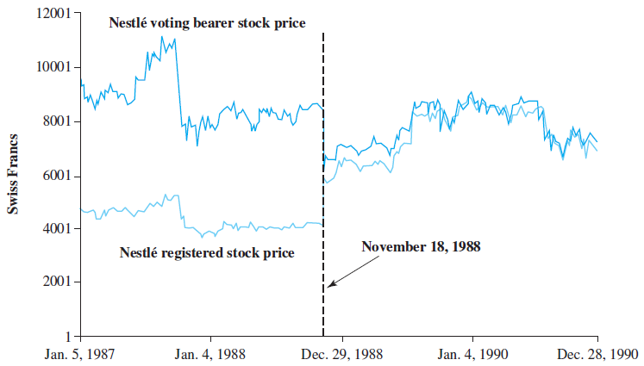
Daily Prices of Nestlé’s Bearer and Registered Shares
1-<number>

Slide 12
Expanded Opportunity Set
Firms may benefit from an expanded opportunity set when they venture into the arena of global markets
  Firms can gain from greater economies of scale when their tangible and intangible assets are deployed on a global basis. Cheaper labor, raw material, etc.
  True for corporations, as well as individual investors
  For example: Coke’s revenue from international markets is 66% and Boeing’s 70%. “It just doesn’t make sense to play in only one corner of the sandbox.”
1-<number>

Slide 13
Goals for International Financial Management
Financial managers need to understand the fundamental concepts and the tools necessary to be effective global managers
  Fundamental goal of sound financial management is shareholder wealth maximization, which means the firm makes all business decisions and investments with an eye toward making the owners of the firm (i.e., shareholders) better off financially
1-<number>

Slide 14
International Businesses
Import /Export – typically an initial method of expanding internationally
Licensing – Licensing the product to be sold internationally. Ex: in stores internationally
Franchise – company allows carrying out businesses in their name.
Strategic Partnering and Joint Ventures
  Mostly FDI
Investing in subsidiaries, international offices, manufacturing plants, distribution centers etc. (MNC)
  FDI
1-<number>

Slide 15
Multinational Corporations
A multinational corporation (MNC) is a firm that has been incorporated in one country and has production and sales operations in other countries
Benefits:
  Cheaper labor, raw material, etc
  Spreading R&D expenditures and advertising costs over their global sales
  Pooling global purchasing power over suppliers (diversification)
  Access to resources. Ex: oil, minerals, etc.
  Utilizing their technological and managerial know-how globally with minimum additional costs
1-<number>

Slide 16
Common Finance Decisions
  Whether to discontinue operations in a particular country
  Whether to pursue new business in a particular country
  Whether to expand business in a particular country
  How to finance expansion in a particular country

Slide 17
MNCs management structures
Centralized – Finance Managers at the parent company level manage all decisions such as cash management, financing, Investment, etc.
Decentralized – Financial Managers at the respective subsidiaries make decisions.

Slide 18
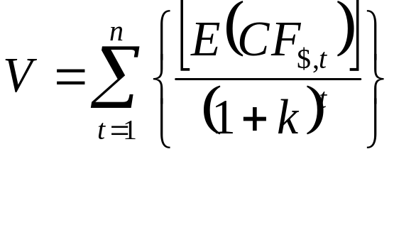
Valuation
Domestic Model:
V represents present value of expected cash flows
  E(CF_{$,t}) represents expected cash flows to be received at the end of period t,
  n represents the number of periods into the future in which cash flows are received, and
  k represents the required rate of return by investors.

Slide 19
Domestic Model
Dollar Cash Flows
  The dollar cash flows in period t represent funds received by the firm minus funds needed to pay expenses or taxes or to reinvest in the firm.
Cost of Capital
  The required rate of return (k) in the denominator of the valuation equation.
  A weighted average of the cost of capital based on all the firms projects.

Slide 20
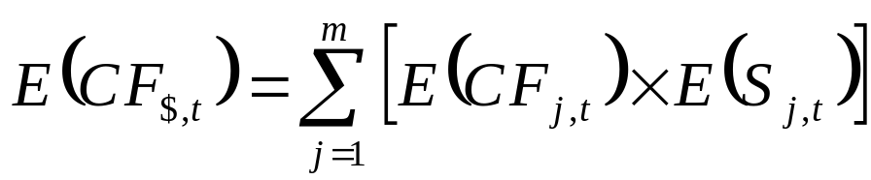
Multi-National Model
  CFj,t represents the amount of cash flow denominated in a particular foreign currency j at the end of period t,
  Sj,t represents the exchange rate at which the foreign currency (measured in dollars per unit of the foreign currency) can be converted to dollars at the end of period t.
Valuation of an MNC that uses two currencies
  Could measure its expected dollar cash flows in any period by multiplying the expected cash flow in each currency by the expected exchange rate at which that currency would be converted to dollars and then summing those two products.

Slide 21
Multi-National Model
  If a firm receives $100,000 from its US operations and 1M pesos from its operations in Mexico. If 1 Peso = $0.05. How much in total cash flows did the firm receive?

Slide 22
Multi-National Model
  If a firm receives $200,000 from its US operations and 300,000 euros from its operations in France. If 1 Euro = $1.03. How much in total cash flows did the firm receive?

Slide 23
Multi-National Model
  If a firm receives $100,000 from its US operations and 100,000 pounds from its operations in UK. If 1 USD = 0.82 pounds. How much in total cash flows did the firm receive?

Slide 24
Corporate Governance
As shown by a series of recent corporate scandals at companies like Enron, WorldCom, and Global Crossing, managers may pursue their own private interests at the expense of shareholders when they are not closely monitored
  This “agency problem” is a major weakness of the international corporation
Reinforces the importance of corporate governance, the financial and legal framework for regulating the relationship between a firm’s management and its shareholders
1-<number>

Slide 25
Agency Problems
The conflict of goals between managers and shareholders
Agency Costs
  Definition: Cost of ensuring that managers maximize shareholder wealth
  Costs are normally higher for MNCs than for pure domestic firms for several reasons:
    Monitoring managers of distant subsidiaries in foreign countries is more difficult.
    Complex regulatory environment
    Foreign subsidiary managers raised in different cultures may not follow uniform goals.
    Sheer size of larger MNCs can create large agency problems.
    Pressure from local stakeholders

